Slide 1
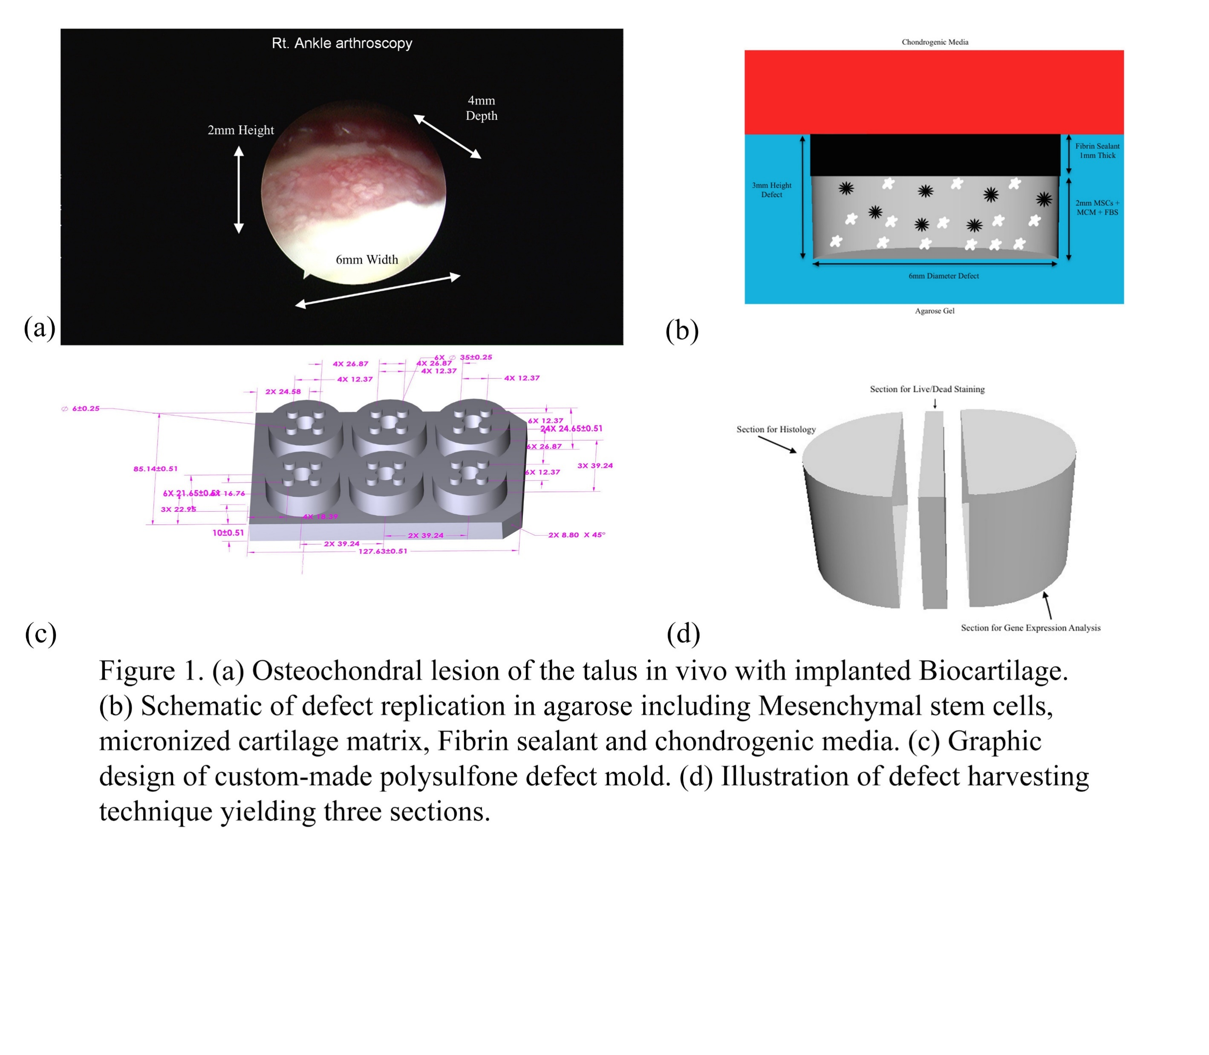
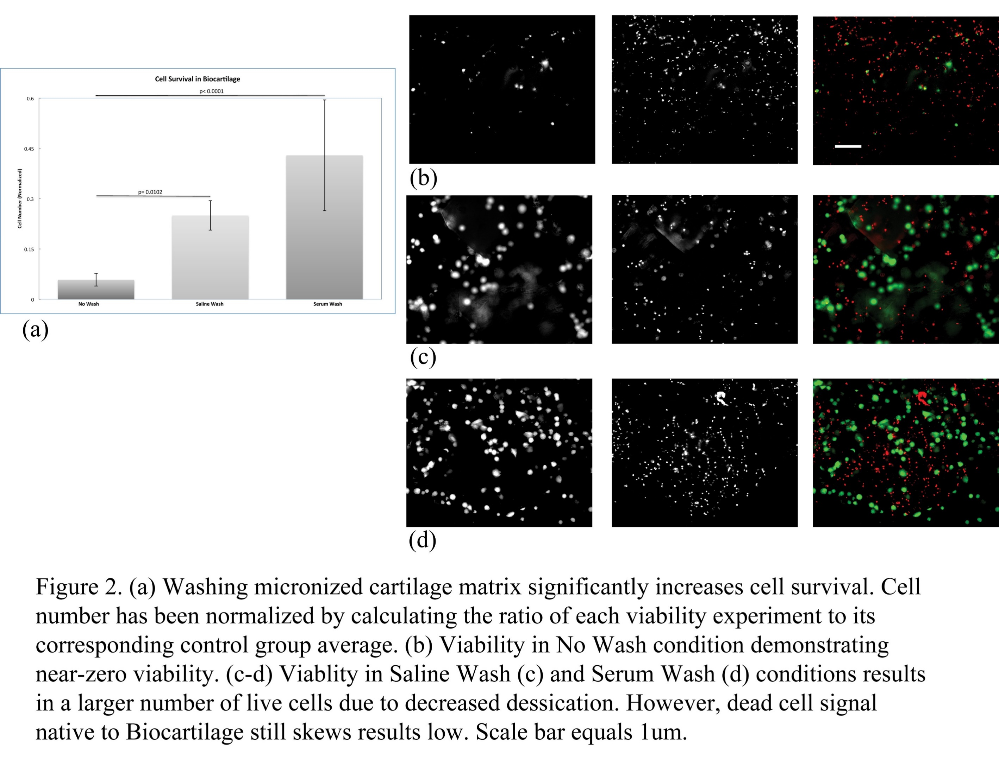
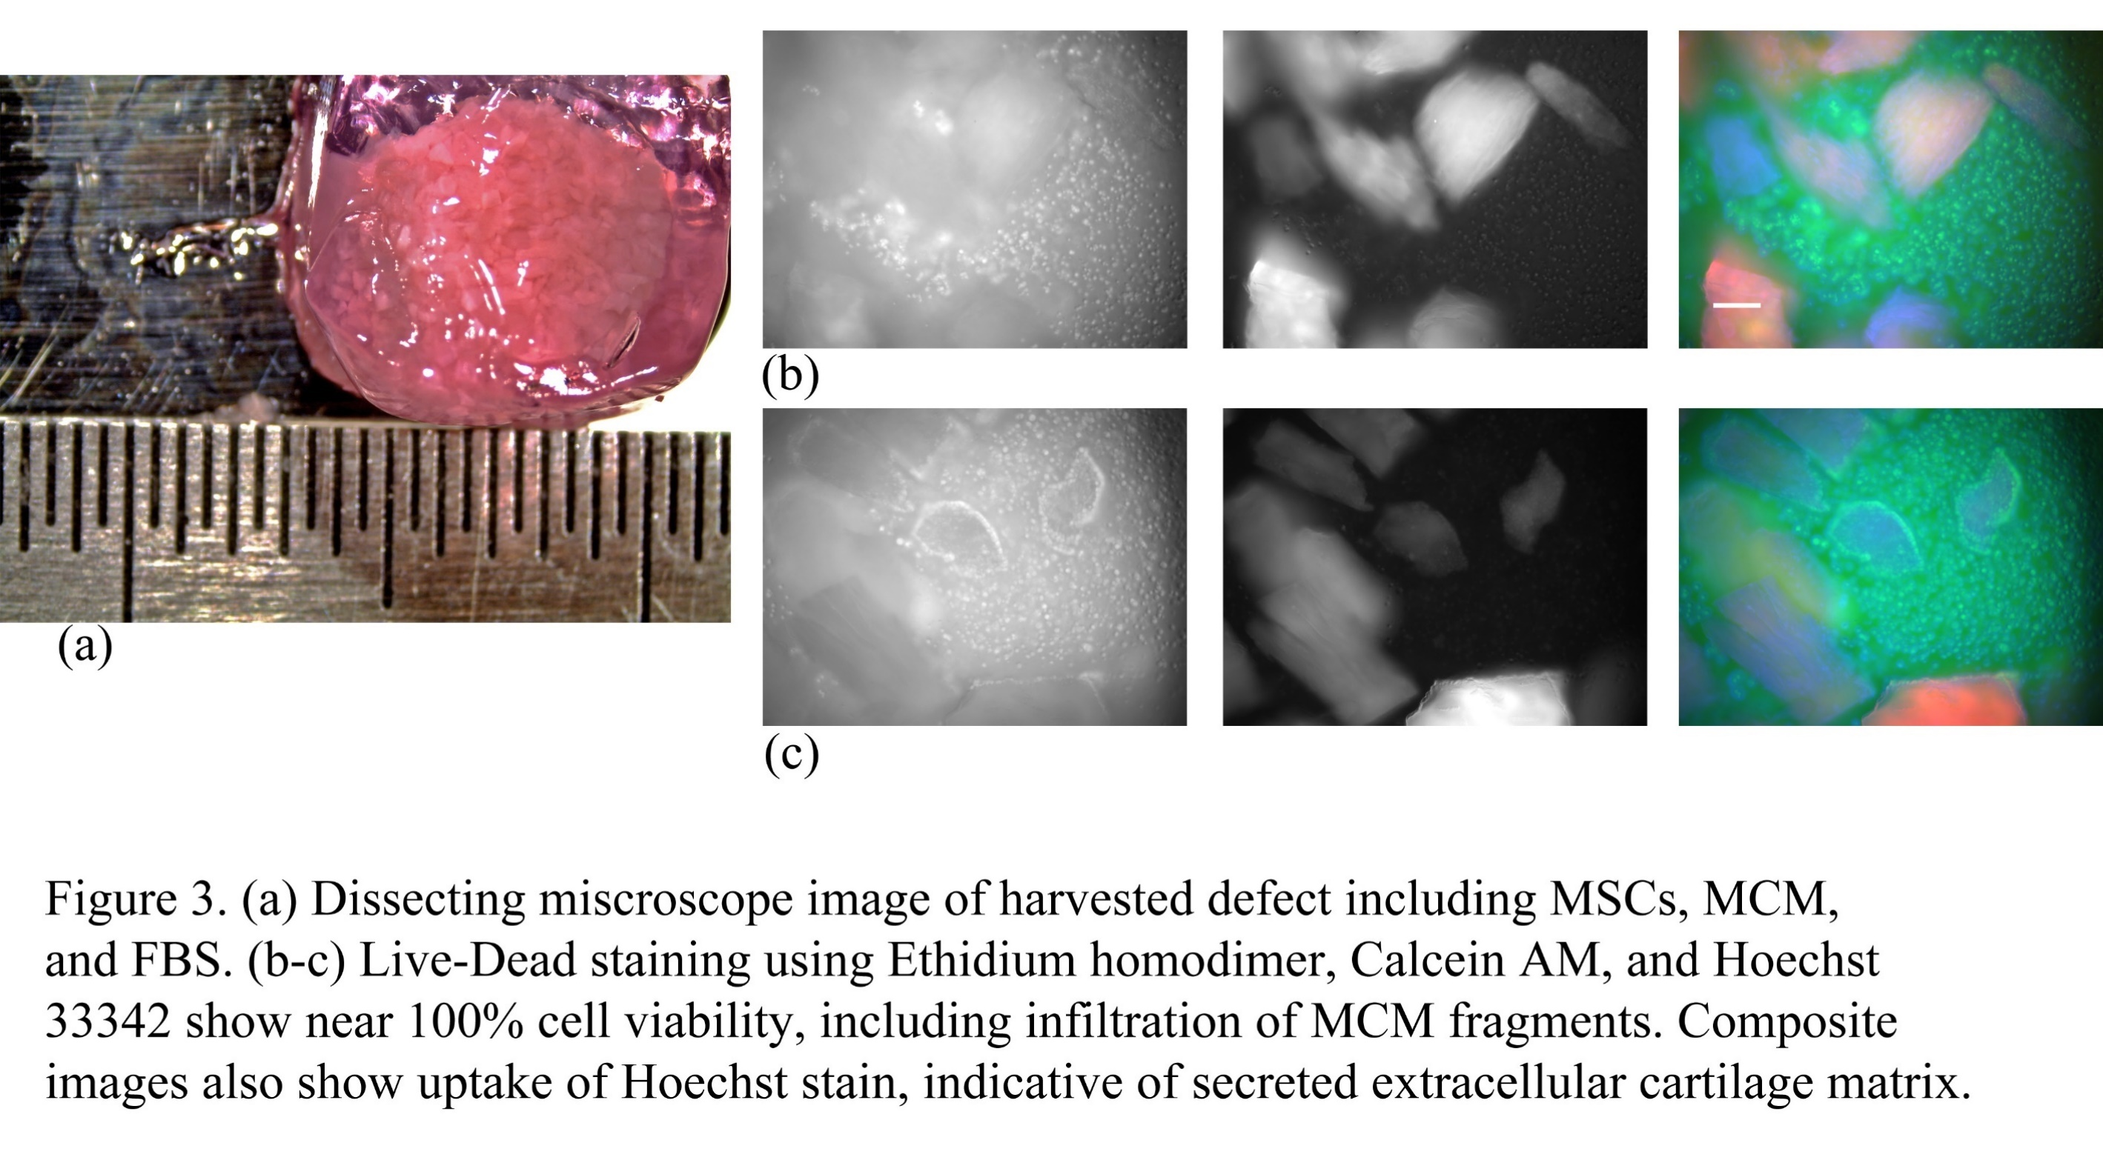
Effects of Micronized Cartilage Matrix on Cartilage Repair in
Osteochondral Lesions of the Talus
Sohni Singh¹, Connor Nathe², Evan Lian³, Jeff Lu¹, Alvin Shieh MD,¹ Dominik Haudenschild PhD¹, Eric Giza MD¹, Christopher Kreulen MD¹
¹University of California, Davis, CA, ²University of California, Irvine, CA, ³Royal College of Surgeons in Ireland, Dublin, Ireland
Objective
To investigate the single stage treatment of osteochondral lesions of the talus (OLTs) with a combination of mesenchymal stem cells (MSCs) and micronized cartilage matrix (MCM)
Background
Traditional marrow stimulation techniques result in fibrocartilage tissue repair
Newer cartilage repair techniques require multiple procedures resulting in high cost and morbidity
Arthrex® BioCartilage® is developed from dehydrated allograft cartilage, processed to 100-300 micron particles, and containing acellular extracellular matrix
Biocartilage is designed to serve as a scaffold to enhance cartilage repair through marrow stimulation
We designed an in-vitro model to mimic the clinical situation, and test the hypothesis that the combination of human bone marrow derived mesenchymal stem cells (MSCs) and MCM would produce hyaline-like cartilage.
Methods
Cells:
Human bone marrow-derived stem cells were obtained and expanded in monolayer culture using standard protocols, to a maximum passage of 4.
Chondrogenic Culture:
Utilized a custom-manufactured polysulfone device with four 6mm diameter x 3mm deep indentations in agarose within in each well of standard 6-well culture plates (Figure 1B, C).
In each well, we placed cells+micronized matrix to a depth of 2mm, which was “sealed” with 1mm depth of TISSEEL fibrin glue as is done clinically.
Control groups had either no cells, or no MCM.
6 ml of chondrogenic media (αMEM with dexamethasone (0.1 µM), TGFβ (10 ng/ml), L-proline, BMP2 (50 ng/ml) and ascorbate-2-phosphate (50 ng/ml)) was added to a height of 6 mm on top of each well, and replenished every other day.
Analysis:
After 3 weeks, cartilage constructs were extracted and divided into 3 sections, each directed to a separate analysis (Figure 1D).
A 300um slice of each defect was set aside for viability, while the two larger sections were dedicated to Histology and Gene Expression analysis respectively.
Viability:
Stem cells were mixed with BioCartilage at ratio of 0.8ml to 1cc of BioCartilage.
Viability was measured using Live/Dead cell viability assays (Thermofisher), and imaged on a Nikon TE2000 inverted fluorescent microscope.
Gene Expression Analysis:
Total RNA was isolated from each defect according to the QIAGEN miRNeasy kits protocol RT-PCR was subsequently used to evaluate mRNA expression levels of the following chondrocyte-specific genes: Collagen Type II, Aggrecan, Link Protein, Collagen Type I and Versican.
Histology:
Tissue samples were immersed in 4mL 4% Paraformaldehyde for 24-40 hours at room temperature, then paraffin embedded, sectioned, and stained with H&E or Safranin-O/Fastgreen.
Experiments were performed with 4 technical replicates, and repeated at least 3 times. Statistical comparisons were made to control groups using ANOVA with Dunnett’s test, in JMP Pro 12.1 software.
Results
After 3 weeks of culture in chondrogenic media, we observed that the stem cells and MCM produced cohesive structures that were easily handled, suggesting chondrogenic differentiation (Figure 2A).
Cell viability is maintained by rehydrating MC prior to mixture with the MSCs.
There was no statistically significant difference between rehydration with serum or saline (Figure 2A).
In constructs that contained both stem cells and MCM, the 3-week cell viability was over 98%.
Conclusions
Micronized cartilage matrix (BioCartilage®) supports cartilage differentiation of MSC’s in vitro when first rehydrated before adding cells.
Preliminary results suggest cartilage matrix deposition occurred surrounding the cells after 3 weeks of chondrogenic culture.
Further studies comparing MSC+MCM against other forms of cartilage repair biologic augments is indicated.
References
Grogan SP, Barbero A, Winkelmann V, Rieser F, Fitzsimmons JS, O’Driscoll S, et al. Visual histological grading system for the evaluation of in vitro-generated neocartilage. Tissue Eng. 2006 Aug; 12(8):2141-9.
Lynn AK, Brooks RA, Bonfield W, Rushton N. Repair of defects in articular joints. Prospects for material-based solutions in tissue engineering. J Bone Joint Surg Br. 2004 Nov;86 (8):1093-9.
Giza E, Sullivan M, Ocel D, Lundeen G, Mitchell ME, Veris L, et al. Matrix-induced autologous chondrocyte implantation of talus articular defects. Foot & ankle international/ American Orthopaedic Foot and Ankle Society [and] Swiss Foot and Ankle Society. 2010 Sep; 31(9):747-53. Epub 2010/10/01.
Nam EK, Ferkel RD, Applegate GR. Autologous chondrocyte implantation of the ankle: a 2-to-5 –year follow-up. The American Journal of Sports Medicine. 2009 Feb; 37(2): 274-84.
Abrams GD, Mall NA, Fortier LA, Roller BL, Cole BJ. BioCartilage: Background and Operative Technique. Operative Techniques in Sports Medicine. 2013 6//;21(2):116-24.
Clanton TO, Johnson NS, Matheny LM. Use of Cartilage Extracellular Matrix and Bone Marrow Aspirate Concentrate in Treatment of Osteochondral Lesions of the Talus. Techniques in Foot & Ankle Surgery. 2014;13(4):212-20.
Muschler GF, Boehm C, Easley K. Aspiration to obtain osteoblast progenitor cells from human bone marrow: the influence of aspiration volume. J Bone Joint Surg Am. 1997 Nov; 79(11):1699-709.
Vangsness CT, Jr., Sternberg H, Harris L. Umbilical Cord Tissue Offers the Greatest Number of Harvestable Mesenchymal Stem Cells for Research and Clinical Application: A Literature Review of Different Harvest Sites. Arthroscopy Association of North America and the International Arthroscopy Association. 2015 Sep;31(9)::1836-43.
Garcia D, Longo UG, Vaquero J, Forriol F, Loppini M, Khan WS, et al. Amniotic membrane transplant for articular cartilage repair: an experimental study in sheep. Curr Stem Cell Res Ther. 2014;10(1):77-83.

